Slide 1


Slide 2
Wizards are everywhere nowadays

Slide 3
However,
Who is be the most powerful wizard?

Slide 4
Let’s learn some magic
and challenge them

Slide 5
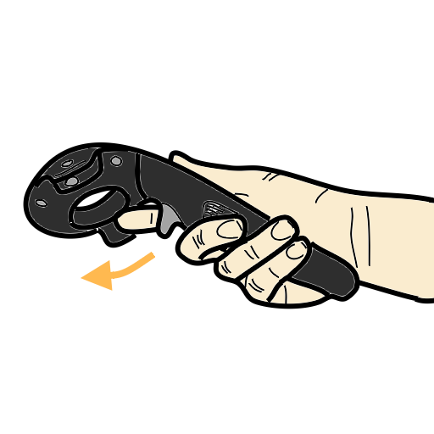
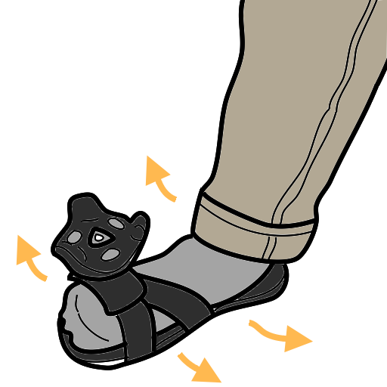
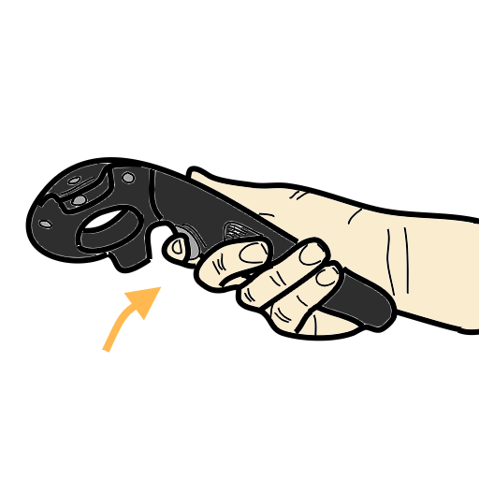
Draw your spell
Release to attack
Hold trigger to draw spell

Slide 6





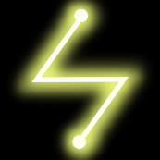
There are five different spells
Heal
Fire
Rockwall
Wind
Lightening

Slide 7

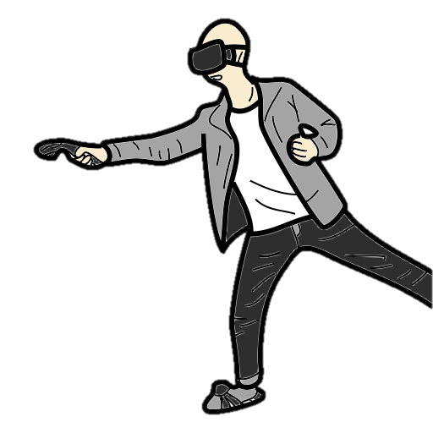
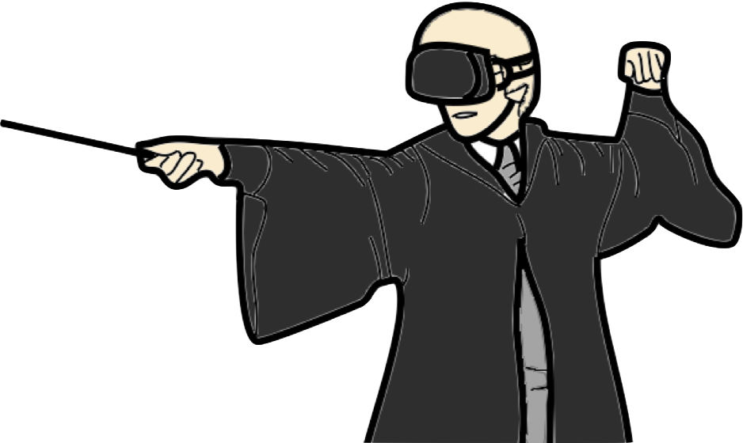

Slide 8
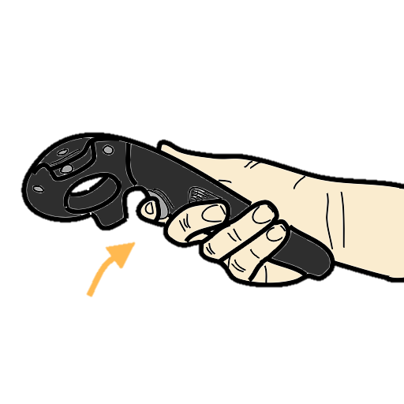
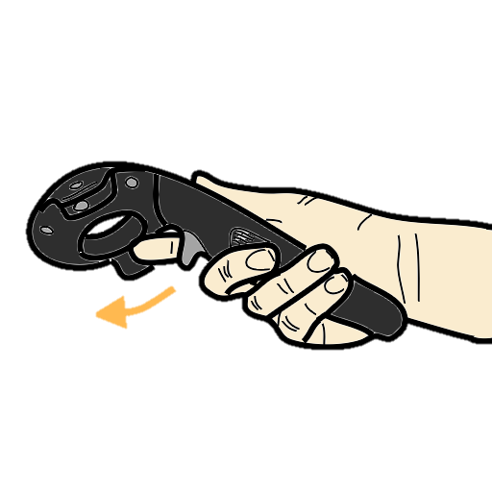
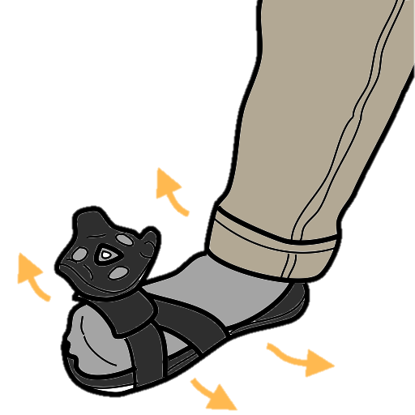
2. Draw magic spell
1. Hold down trigger
3. Release trigger and attack

Slide 9
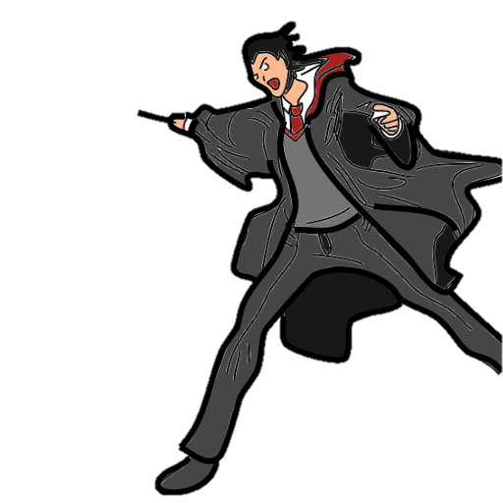
5. Like a Boss !!
4. You are a wizard

Slide 10
Magic Spell
Heal
Fire
Rockwall
Wind
Lightening

Slide 11
Heal
Fire
Rockwall
defense
A
B
Wind
Lightening

Slide 12
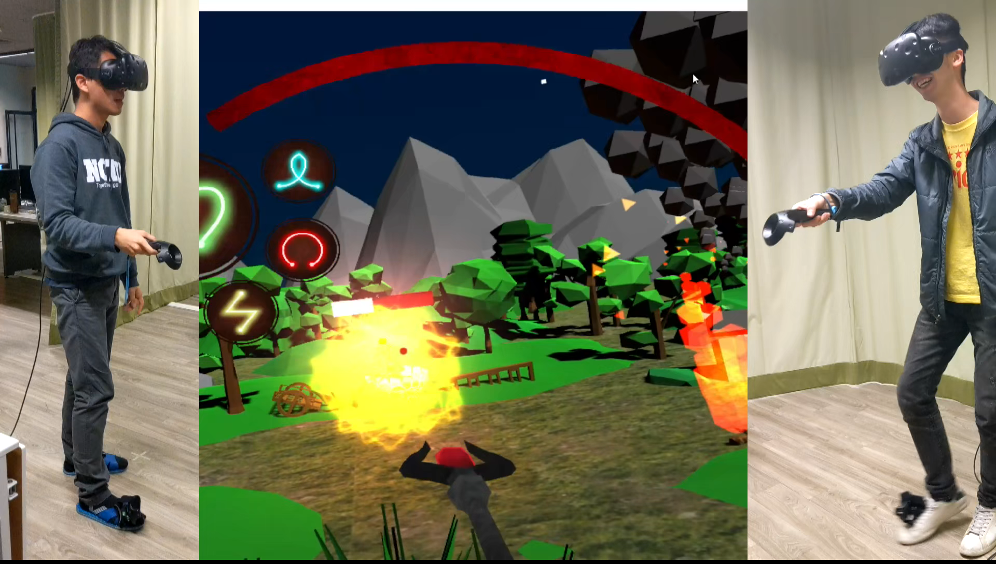
https://youtu.be/gUnqX9qbpFA

